Slide 1
Neighbourhood Partnership as a Catalyst for New Approaches & Innovation
Nicola Evans – Integrated Partnership Manager

Slide 2
Refresher! 3 Types of Frequent Attenders
Acute
Entrenched Cyclical
Mischievous

Slide 3
Frequent Attendee’s
Keep Chipping Away
Childhood Trauma
Crushed
Domestic Abuse
Rejection
Addiction
Depression
Criminal Justice
Loneliness
Relationship Breakdown
Warm the Water

Slide 4
The solution therefore lies in the Community, and the challenge for NHS colleagues is to develop within existing structures an effective system and way to achieve robust virtual team working!

Slide 5
The interface between health services and community based services
For die-hard health professionals – bridging the gap between acute services and local communities is unchartered territory!
“Faith is taking the first step even when you don’t see the whole staircase”
Martin Luther King Jr

Slide 6
How does it work “out there”?
Each Local Authority area does the world of Partnerships differently!
However, 4 Statutory Partnerships exist across Wales & the UK??
Community Safety Partnership
Children & Young People’s Partnership
Health Social Care & Well-Being Partnerships
Local Safeguarding Children’s Boards (to become Regional Safeguarding Boards)

Slide 7
The Mandate…….
Each Partnership is mandated to develop local strategies and plans to meet the needs of their population.
The Future Generations & Well-Being Act (Wales) 2015 brings all of this together and places accountability on Public Service Boards to deliver.

Slide 8
Frequent Attenders within the Context of Local Partnerships: The Cardiff Experience
Cardiff is different from other Local Authority area’s in that they merged the statutory partnerships and developed an integrated partnership and integrated partnership strategy based on joint local needs assessment.
But……………how to deliver?

Slide 9
Delivering Strategy in the Community in Cardiff: Working Differently Using a Neighbourhood Partnership Approach
We needed a model that was: -
an innovative solution to try to achieve real multi agency joint problem solving
could be developed with no additional resources
high level support by services leaders, namely the Cardiff Partnership Board

Slide 10
The Neighbourhood Partnership Model: Aims
To tackle neighbourhood issues, concerns and priorities and improve the quality of life for citizens through the local organisation, co-ordination and delivery of core civic and community services within a defined neighbourhood area
Our story………….

Slide 11
The Complexities of ‘Neighbourhoods’ mapping exercise – the Cardiff Story
4 health
Areas
(5 for Mental
Health)
29 Electoral
wards
6 Police
areas
Citizen?
50+ PACT
Areas
4 fire areas
(+ bit of
Vale)
203 Lower
Super
Output
Areas

Slide 12
The Dilemma
Relevance
Need to be close
enough
to “ground level”
Effective
Not so many they
Can’t be supported
by key decision
makers

Slide 13
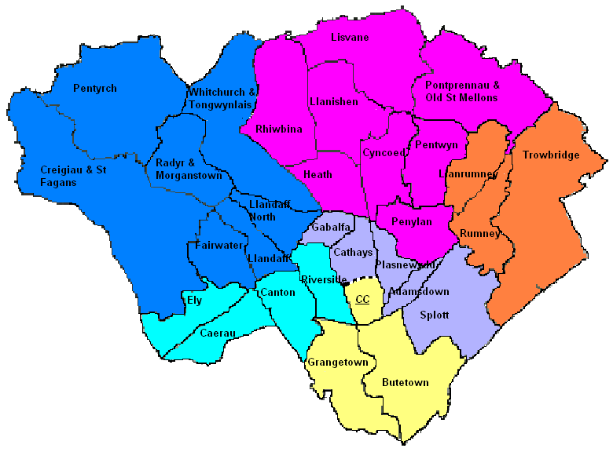
6 Neighbourhood Partnership Teams
Cardiff North
Cardiff West
Cardiff
East
Cardiff South West
Cardiff South East
City & Cardiff South

Slide 14
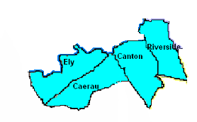
The Cardiff Neighbourhood Management Model – step 1
Neighbourhood Police Inspector, Sgts, PCs,
PCSOs and Specials
Neighbourhood Policing Model
(already in place)

Slide 15
The Cardiff Neighbourhood Management Model
Neighbourhood Police Team
Other locality-based staff (e.g. Communities First, RSLs, voluntary organisations, head teachers, Youth Services, Social Services, Fire Station Commanders, district housing officers, clinics, wardens etc.,)
Resources largely already in place but not co-ordinated or joined up

Slide 16
The Cardiff Neighbourhood Management Model – Step 2
Neighbourhood Police Team
Other locality-based partners
In joining these two boxes up and co-ordinating as ‘teams’ we have the basis of multi-agency neighbourhood partnerships

Slide 17
The Cardiff Neighbourhood Management Model – step 3
Neighbourhood Police Team
Other locality-based partners
130 OMs divided across 6-12 neighbourhood management teams…
Nici Evans CCC

Slide 18
The Cardiff Neighbourhood Management Model – Step 3
Highways, Transport & Waste
Children’s Services
Adult Services
Housing & Communities
Lifelong Learning
Etc.
Cardiff Council’s Operational Managers divided across service area silos

Slide 19
The Cardiff Neighbourhood Management Model – Step 3
Voluntary Sector
C1st
CCC
C&V UHB
Probation
Etc.
More staff from different service areas are identified…

Slide 20
The Cardiff Neighbourhood Management Model – step 3

Slide 21
Step 3 – South West Cardiff Neighbourhood Partnership Team
Neighbourhood Police Team
Other locality-based partners
Multi-agency problem-solving team for Ely, Caerau, Canton & Riverside Emphasis on ‘virtual’ working… rather than re-alignment of partners’ existing operational areas
Public Sector Managers with ‘clout’

Slide 22
The Benefits of Working in this Way
Brought partners together in locality focused problem-solving teams
Allowed a route for programme-bending to Communities First areas
Made real differences to local communities

Slide 23
Neighbourhood Partnership therefore offers a structure that is…….
a mechanism for change which is focused on finding solutions
a way of making the connections real at a community level
a process, not a project or a fund
about improving mainstream services and promoting integrated services
spending existing money better

Slide 24
Working with Neighbourhood Partnerships to Support Frequent Callers & Attenders
Already had tried and tested models working to tackle complex issues in the Neighbourhood’s
Most relevant one for Frequent Attenders Project was the Young People’s Not in Employment, Education & Training (NEET’s) Programme

Slide 25
Youth Engagement and Progression Panels
This project promotes the engagement and progression of young people 16 -19 years old into education, training and or employment within the communities of Cardiff.
Panels were established 3 years ago on the basis of Cardiff’s Neighbourhood Partnership structure. The Panels manage case loads of young people who are currently not engaged in education, training and or employment and partners are required to report the progression of case loaded young people to the panel on a monthly basis.

Slide 26
Borrowing with pride…..
The transferability of this project was clear to everyone from the outset as a way of supporting and managing patients who use emergency services frequently

Slide 27
Conclusion
Our pilot project has demonstrated clearly the value of using an established mechanism for multi-agency working to address this complex issue. It offers a pragmatic solution to local needs assessment, problem solving and service delivery. Finally, the model demonstrates the value of ‘virtual’ team working

