Slide 1
RESPONDING INNOVATIVELY TO THE NEEDS OF COMPLEX PATIENTS – Setting the Scene
Claire Bevan
Executive Director of Quality, Safety and Patient Experience
Welsh Ambulance Service NHS Trust

Slide 2
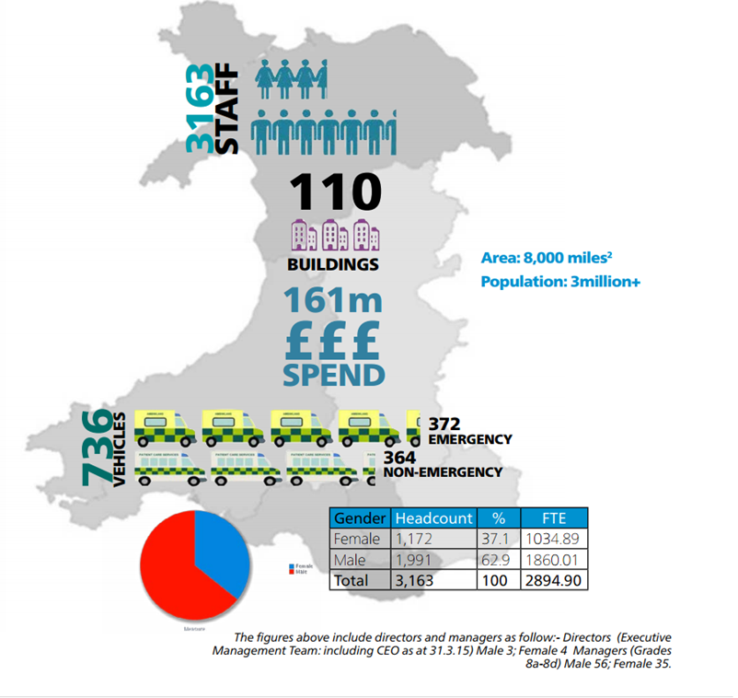
Background

Slide 4
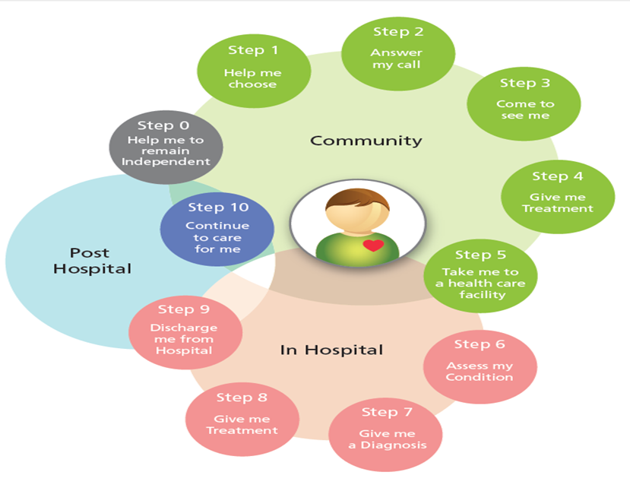
WASTs Role in the Unscheduled Care Pathway

Slide 5
Step 1 – Help me choose & NHSDW Inputs
Gateway to ‘Consumer’ Health Information
Work with Public Health Wales - Choose Well Campaign
Visits to the website increased overall from 2007/08.
Over 20 Self Assessment Symptom Checkers including:
Cold/Flu
Vomiting
Dental
Abdominal Pain
Ear problems
Choose Well quiz ‘Take the Choose Well Challenge’
Wellbeing Self Assessment Tool
Pregnancy Guide

Slide 6
Step 2 - Answer my call
Quest for Quality
Improvement
Clinical Desk – Paramedics & Registered Nurses
4,000 Calls triaged per month
800 -1,000 Ambulances stopped per month
Right Resource
Right Time
Right Place
HEAR AND TREAT
Clinicians
Reduces the number of ambulance dispatches.
Reduces ED attendance in some cases
Notes:
Sian – has changed details that were in original slide

Slide 7
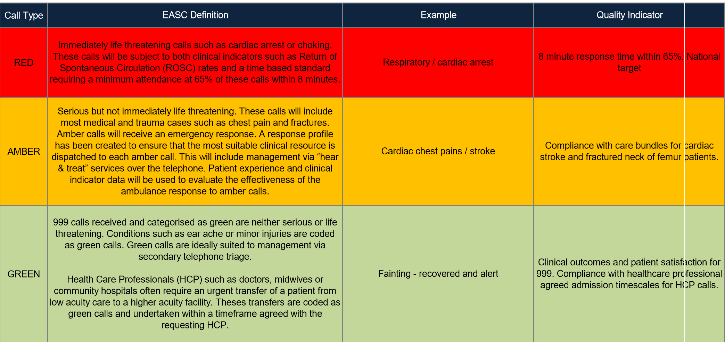
Step 3 – Come to see me: Response Categories

Slide 8
Step 3 – Come to see me: Response Categories

Slide 9
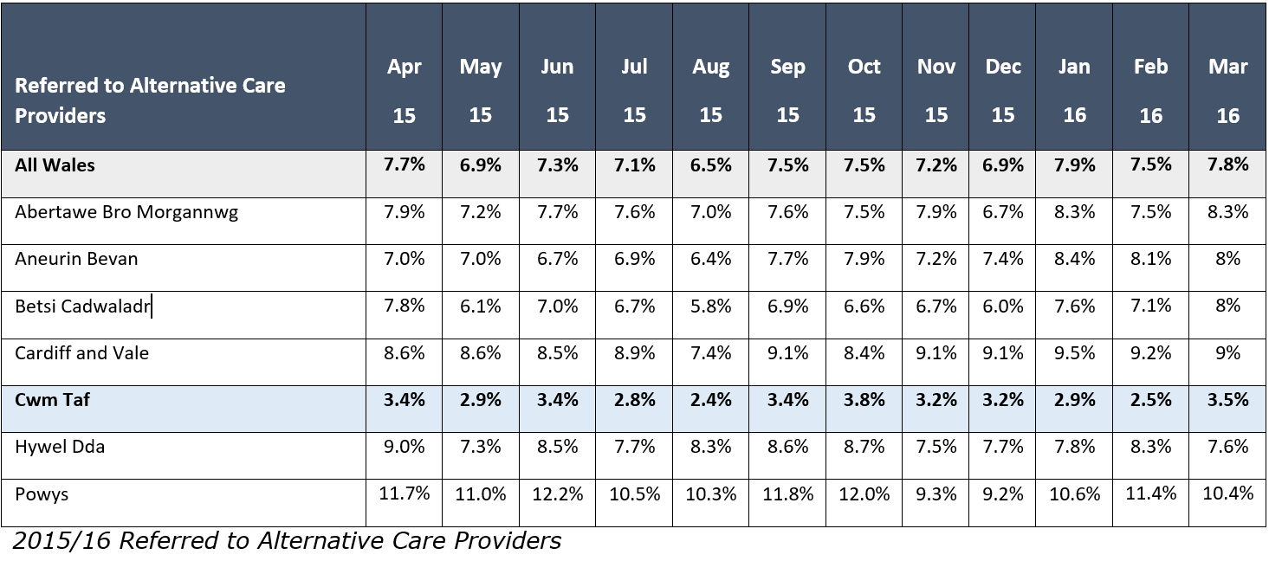
Step 4 – Give me treatment

Slide 10
Step 5 – Take me to hospital
WAST IMTP 2016/19: Priority: Conveyance rate reducing to 65% over 3 years n
Challenges
Empowering clinicians regarding conveyance decisions
Alternative pathways of care being in place to refer to pan Wales

Slide 11
Challenges facing NHS Wales at the moment
The Need Challenge - Rising demand for NHS services
The Workforce Challenge - Planning for sustainable and resilient workforce
The Financial Challenge - Recognising the Financial Pressures
The Integration Challenge - Focusing on partnership and collaborative working
The Public Health Challenge - Investing in prevention and early intervention

Slide 12
Role of Unscheduled Care in facing these challenges
Reducing demand by targeted response to needs eg. Frequent Attender work
Partnership working - becoming more outward facing and engaging with local communities
Data sharing and analysis – become part of the solution

Slide 13
Ten High Impact Steps to Transforming Unscheduled Care
This is a product of the WG Unscheduled Care Programme Board
It highlights the key steps to transform the unscheduled care pathway, and is a resource to support improvement and change, generate ideas and create the climate of innovation required to deliver safe, effective and efficient services for unscheduled care

Slide 14
Ten High Impact Steps to Transforming Unscheduled Care – Step 7 – Target Frequent User Groups
Health and social care partners agree a co-ordinated model to identify and support those groups of patients with high USC use, or who have the potential to be high USC users
Multi-disciplinary/ agency teams can develop care plans and ensure that these plans are available and actioned during USC encounters.
An integrated health & social care team is the model most likely to succeed
Intended Outcome: The reduction of USC attendances, admissions and re-admissions for this group of patients

Slide 15
Wider Policy Framework in Wales that Mandates Frequent Attender Work & Recent Legislation
Social Services and Wellbeing (Wales) Act 2014
Wellbeing of Future Generations (Wales) Act 2015
‘Together for Mental Health’ (2016) the Welsh Government’s strategy to improve mental well-being in Wales. 10 priority areas are outlined, including support for young people, addressing dementia, ensuring services are provided in a timely and effective manner, and targeting groups at a higher risk of mental health issues

Slide 16
Social Services and Well Being (Wales) Act 2014
An Act of the National Assembly for Wales to reform social services law
It is about improving the well-being outcomes for people who need care and support and carers who need support;
It makes provision about co-operation and partnership by public authorities with a view to improving the well-being of people;
It makes provision about complaints relating to social care and palliative care; and for connected purposes

Slide 17
Social Services and Well Being Act – what does it mean for Statutory Providers?
Part 9: Co-operation and Partnership
requires Local Authorities to make arrangements to promote co-operation with their relevant partners and others in relation to adults with needs for care and support, carers and children
imposes a duty on the relevant partners to co-operate with, and provide information to the local authorities for the purpose of their social services functions
makes provision about promoting the integration of care and support with health services
provides for partnership arrangements between Local Authorities and Local Health Boards for the discharge of their functions

Slide 18
Overview of the Wellbeing of Future Generations (Wales) Act 2015
This Act is about improving the social, economic, environmental and cultural well-being of Wales
The Act will make the public bodies listed in the Act think more about the long term, work better with people and communities and each other, look to prevent problems and take a more joined-up approach
This new law will mean that, for the first time, public bodies listed in the Act must do what they do in a sustainable way
Public bodies need to make sure that when making their decisions they take into account the impact they could have on people living their lives in Wales in the future

Slide 19
Wellbeing of Future Generations Act: The Goals

Slide 20
Wellbeing of Future Generations Act – what does it mean for Frequent Attenders
Health Boards will have a duty to maximise contribution to wellbeing goals, in accordance with sustainable development principles
They will be expected to work in collaboration with the partner agencies on their Public Service Boards to set local objectives and take reasonable steps to meet these objectives

Slide 21
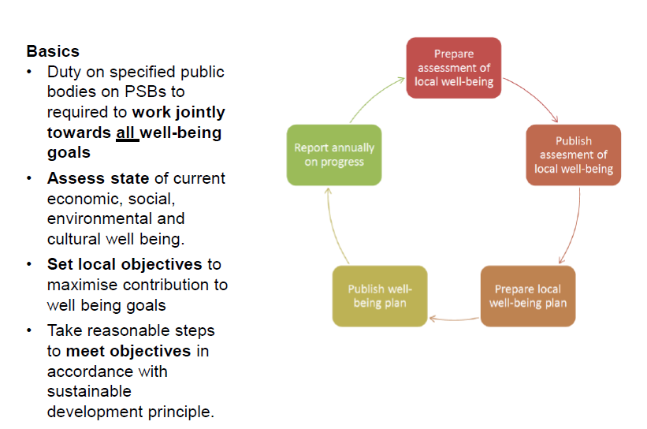
Public Service Boards…

Slide 22
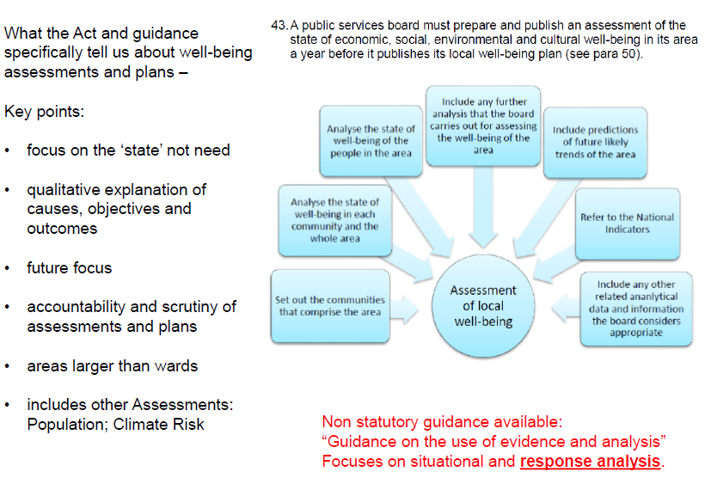
Well-being Assessments

Slide 23
How to survive the NHS:
“The NHS Blinkers”

Slide 24
The FGWB Act's Sustainable Development Principles
• Long-term thinking - balancing short-term needs with safeguards to meet long- term needs
• Prevention - actions to prevent problems getting worse
• Integration - considering how your objectives may impact on those of others
• Collaboration - Working with other bodies (which may include third sector organisations) that can help you meet your goals
• Involvement - involving people and communities with an interest in
helping you meet your objectives, and reflecting the diversity of the people in your area.

Slide 25
The relationship between well-being & those who frequently use emergency services and unscheduled care

Slide 26
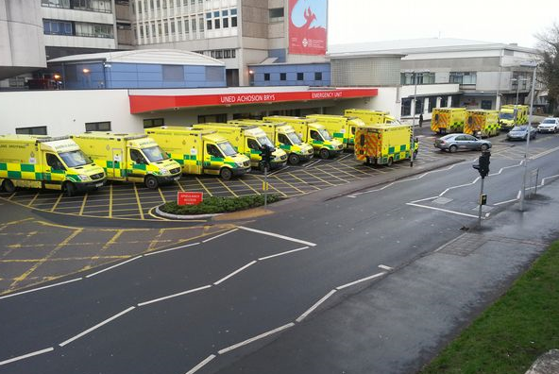
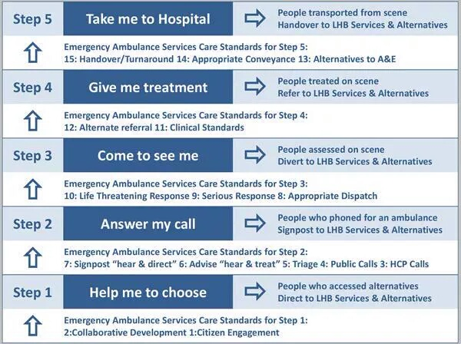
Transition of Care Closer to Home Pan Wales

Slide 27
The way forward……………..
Could the reason that those who use emergency services frequently have a poor sense of well-being and not actually need acute services? If so, have we have focused for too long on the treatment of illness?
Today is to consider the challenge of looking beyond and considering the role of health, public and 3rd sector services in addressing the well-being of our patients/carers/public. To think creatively about supporting and involving them more effectively, so that emergency services become part of a wider integrated team – working in COLLABORATION and TOGETHER whilst focusing on PREVENTION.

Slide 28
“Rarely do we find men who willingly engage in hard, solid, thinking. There is an almost universal quest for easy answers and half-baked solutions. Nothing pains some people more than having to think” Martin Luther King Jr

