Slide 1
WEDFAN 2016 “INNOVATION THROUGH LEGISLATION”
WELCOME
Anna Sussex
Notes:
hello everyone, and welcome to our very first conference! I hope you all had a safe journey here, and have had a coffee and a chance to relax and settle in for the day
my name is Anna, and I am the founder of WEDFAN. I am also an emergency department sister, having worked in ED in Cardiff for 16 years. I will be taking us through the day, and am very much looking forward to having a chance to meet you all, hear your experiences and learn from you
I know there are Frequent Attender Teams here from various health boards, and I see this day very much as an opportunity for everyone to learn from each other, myself included. I know the presenters are all Cardiff based - this is not because I feel that we are the ones who know it all, but because up until 2 weeks ago, we had no secured funding for today, so I have been gratefully supported by my colleagues free of charge!
This afternoon we are split into two groups, to go into the workshops. I have divided us up into health boards for 2 reasons, one so that each group has a Frequent Attender Team in it, so that you can share what you have learnt, and your journey so far, and two, on the understanding that as a health board team, you know your individual service pressures and unique issues, and I felt it may be easier to learn and feedback together. Your delegate badges have the letter A or B on them, your first workshop with correspond with that letter and then you will swap to the next one
I just need to go through some housekeeping matters

Slide 2
HOUSEKEEPING
Toilets
Fire Alarms
Breaks
Mobiles
Twitter – @WEDFAN_NHS #WEDFAN16
Notes:
the toilets are:......
there are no fire alarms set for today, so if the alarms go off, we need to meet outside.....
we have scheduled breaks at various times through the day, so hopefully you wont need to survive too long without a comfort break
if you need to smoke, the smoking areas are....
please keep your mobiles on vibrate, but please do feel free to tweet about the day. If you are not following us already, we are on twitter as WEDFAN_NHS, please tweet using #WEDFAN16.

Slide 3
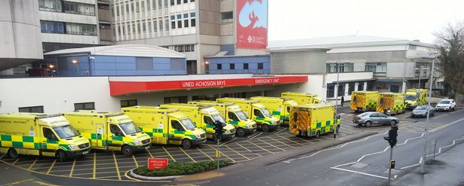
WHY ARE WE HERE?
Each day in Wales:
1,200 999 emergency calls are responded to
800 people are conveyed to hospital by ambulance
2,100 people are treated in ED
600 people are treated in MIUs
Notes:
so, why are we all here?
it's no surprise that the NHS as a whole is struggling, and that emergency departments are getting busier year on year. Despite that, we have a shortfall in clinicians, tighter resources and we seem to have lost that light at the end of the tunnel
however, those of us who work on the front line are resilient, and innovative and continuously strive to give the best care possible to our patients
One of those groups of patients are our frequent attenders - those patients who call our ambulances and attend our departments on a regular basis, and for a variety of reasons. I am sure we all have that heart sinking feeling when we see that familiar name again, and know that whatever we do, we never seem to fix them. We have some patients who ring an ambulance 3 times a day - I am sure that is a familiar scenario to many of you

Slide 4
AIMS OF THE DAY
Understand the problem
Explore the solutions – both current and future
Plan the way ahead
Notes:
so today we need first to understand who these patients are, and why they are coming to us. Once we know their triggers, we can start looking at how we prevent those triggers resulting in ED attendances. to do that, we need to understand what is out there in the community to help support these patients in a different way, one that is more suitable for their needs
We will hear about how the legislation in Wales is encouraging an integrated health and social care response to patient needs, and how we can use that drive to create a new service for our frequent flyers.
As budgets get tighter, and services get cut or reduced, the impact on our most vulnerable patients is and will be immense
This problem will not go away, frequent flyers will not go away. As their support networks are removed, we will be the last man standing for many of them. Our departments are always open, our paramedics are always on duty and we are often the only place they feel they can access warmth, food, care and support
however, we are not the answer, but we can be part of the solution. they are our patients, we must still be their advocates, however frustrating we find them!
today is an opportunity to explore our options, to discuss what is already happening in Wales, to look at what else we can do. There are teams here already working with FFs, so there is much we can learn, discuss, plan and work with
Those of us who work in unscheduled care have a national remit to look at this group of patients. The National Unscheduled Care Programme Board have put frequent attenders into their Ten High Impact Steps to improve Unscheduled Care, and Claire Bevan will be exploring this in more detail in her presentation this morning. I would like to get to the point where we have a national steering group of emergency and primary care clinicians plotting the way forward with our frequent flyers, creating an all Wales policy and forging strong partnerships with our community partners
In order to do this, we need to work with our partner agencies in the community - the answer to our frequent flyers lies very much within integrated, multi agency working. Gemma Hicks from Communities First, a Welsh Government funded programme, whose role is to narrow the economic, education/skills and health gaps between our most deprived and more affluent areas, will discuss in her presentation what support they can offer us and our patients to help reduce their attendances. There are 52 Community First cluster areas in Wales, and they have 3 main strategic aims – to increase prosperity, to increase health and to increase knowledge and education within the poorest areas of our community.
Nici Evans is the Integrated Partnership Manager for Cardiff, and her role sits within health and local authority. She will be telling us about the neighbourhood partnership schemes, and how they are applicable to how we roll out any new pathways into the community from the hospital based setting.
this afternoon, in the workshops, we will go through the realities of setting up an integrated, multiagency service, we will look at IT, data sharing, finance, paperwork etc. That workshop is run by myself, psych liaison and the Welsh ambulance service. in your packs are 3 different types of management plans, they are real plans we use in Cardiff, but are for particularly difficult patients to manage - there is one for use where you need a capacity assessment, one where the patient was deliberately misusing the service and we ended up taking her down the criminal justice route, and one is for a withdrawal of service, where we now only offer emergency stabilisation treatment, and no more. if you get the chance to look at these before your workshop, you may find it useful. the other workshop is being run by Communities First and Cardiff Council Housing Options - this is an opportunity to work through some case studies to find out what support can be given to patients. again, these are real patients that we have in Cardiff, and real solutions. Ceri from housing is a guru on housing law and the realities of working with homeless patients, or those in hostels or temporary accommodation
At the end of the day, we will have a 30 minute session where I hope we can have a free floor discussion on where we go from here. my "vision" is an all Wales policy, a national steering group, regular conferences, and a real commitment to creating a reactive, integrated response to this patient group

Slide 5
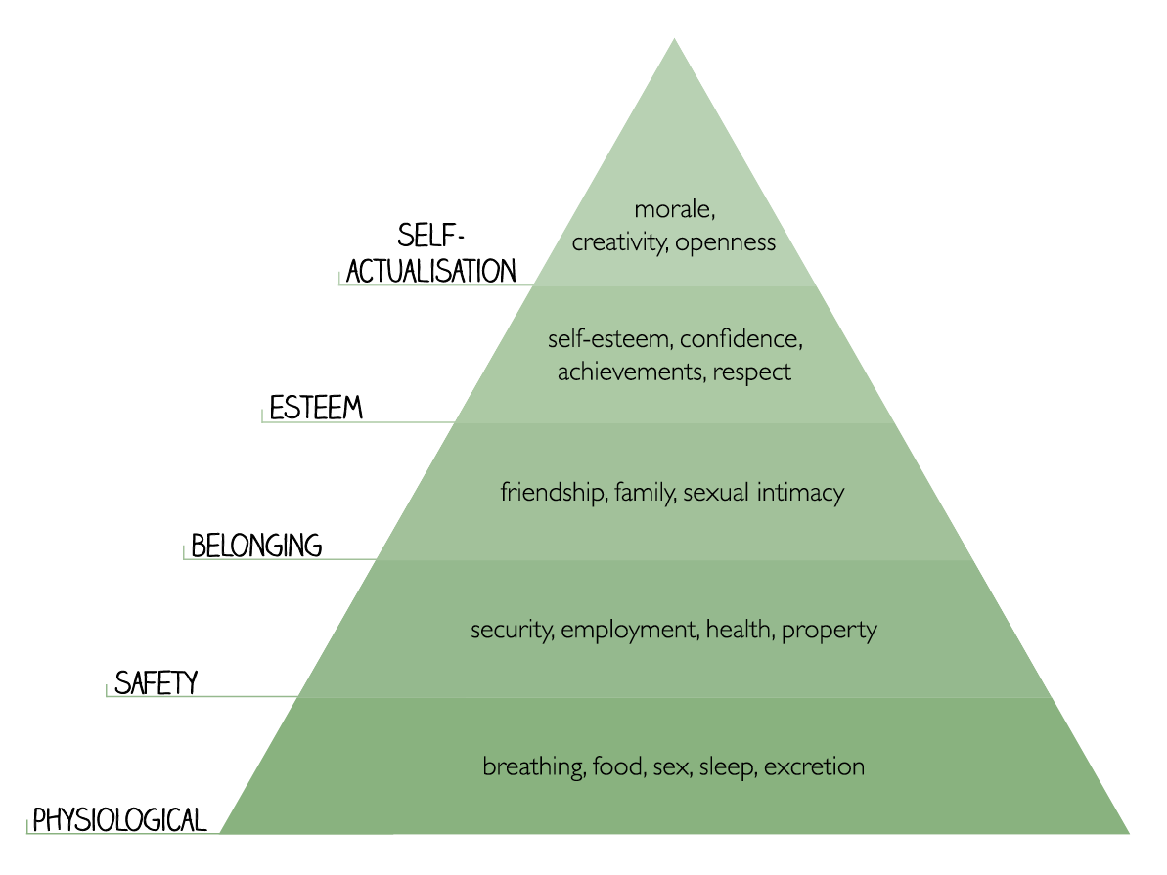
MASLOW’S HIERARCHY OF NEEDS
Notes:
before we really start the day, I want to introduce you to a patient, and want you to keep this patient in your mind as we go through the various presentations
in order to understand him, we need first to look at ourselves - and in particular, where we sit within Maslows hierarchy of needs. Everyone knows Maslow's Hierarchy of needs – the basic tenets on which we function as individuals and as a society. As health care professionals, we will, mostly, be able to tick off the majority of these. What we need to do is understand where our frequent flyers sit, do they feel that they could tick off each level?
And so I want to introduce you to Greg....

Slide 6
GREG – A CASE STUDY
39 year old male
Street Homeless
Alcohol Dependent
Single
Has children
Comes to ED intoxicated, soiled, vomiting over himself
Goes on a trolley, lies in a stupor until discharged
Not referred to services as already in the system
Asks for bus money – which he then takes to the shop down the road –and buys cider
Falls asleep in the street – passerby calls 999 – he arrives back in the department
Notes:
Every one has a Greg – we do nothing for him, we offer him showers, fresh clothes etc, none of which he takes us up on. He will sleep, and on waking bimble around the department saying hi to everyone. He’s been there as long as I have – he knows most of the nurses, in fact, he feels really protective of us, and will often have a go at patients he thinks are disrespecting the staff. And yet, despite that grudging like we all have for him, he is an absolute drain on resources, he takes ambulances off the roads for deep cleans, he never goes to appointments set up for him, he doesn’t want to stop drinking, he walked out of 2 emergency detoxes we organised for him….

Slide 7
GREG - MASLOW'S HIERARCHY OF NEEDS
BIOLOGICAL AND PHYSICAL NEEDS - He has no shelter, no warmth, no regular food or drink. He has unsafe sleep
SAFETY NEEDS - He has no security, no stability, no order in his life
BELONGINGNESS AND LOVE NEEDS - he has no family, no affection, he doesn't belong to any group – apart from other drinkers
ESTEEM NEEDS - He knows he smells, he’s aware people look down at him, he knows there is a stigma around him
SELF ACTUALISATION - He feels a failure, he’s lost his family, he has no further education or training, has never worked
Notes:
So lets look at where he sits within Maslow's Hierarchy of Needs ….....

Slide 8
SO WHAT ARE WE LEFT WITH?
Emptiness
Brokenness
Bitterness
Anxiety
Rejection
Feeling Crushed
Fearfulness
Heartbrokenness
Feeling Useless
Loneliness
Depression
Rejection
Defeated

Slide 9
This is why they come to us - not because they have overdosed, or because they have pain, or because they are drunk but because they are broken and rejected.
And this is why we cannot fix them, because we are not dealing with the root of the problem – we are attempting to put a plaster over an axe wound

Slide 10
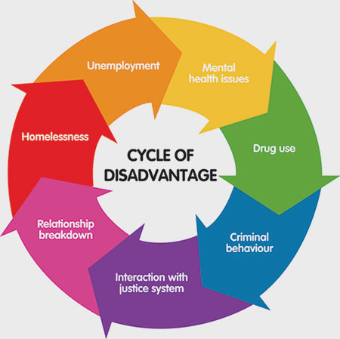
UNDERSTANDING THE PATIENT

Slide 11
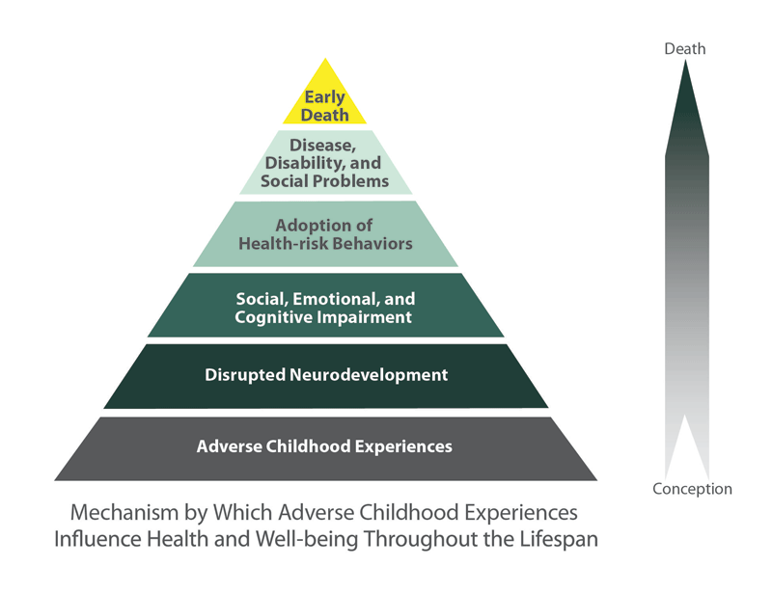
GENERATIONAL LAYERS OF ISSUES

Slide 12
GREG’S TRIGGER EVENT
His child died when she was 18 months old
We cannot successfully detox him, because alcohol is not the problem
Alcohol is his solution to a far deeper problem
Dealing with that problem is the answer to his attendances in ED
That needs a vast array of services to work together to provide not only detox, but counselling, post detox support, education, employment and housing
That is why we are here today – to be the people who create that integrated service, that meets the needs of the most vulnerable people in our society

Slide 13
ALL OF THIS CAN SEEM OVERWHELMING – HOW DO WE MAKE A CHANGE IN THIS HUGE TIDE OF EVENTS?

Slide 15
“A deep sense of love and belonging is an irreducible need of all people. We are biologically, cognitively, physically, and spiritually wired to love, to be loved, and to belong. When those needs are not met, we don’t function as we were meant to. We break. We fall apart. We numb. We ache. We hurt others. We get sick” – Brené Brown

