Slide 1

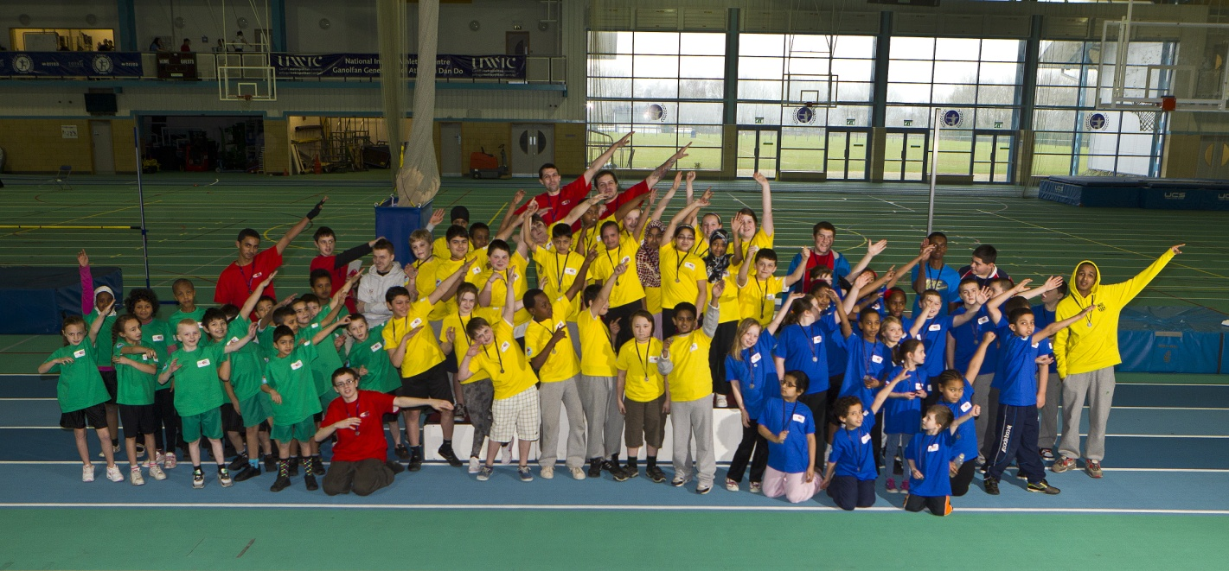
STAR Communities First
Frequent Fliers
Gemma Hicks - Deputy Cluster Manager
Community Involvement and Health

Slide 2


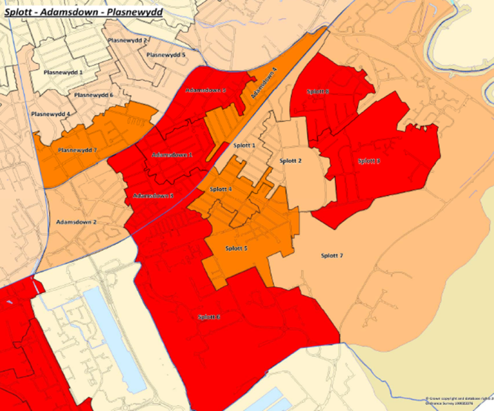
Communities First
The Programme
Flagship Welsh Government anti-poverty programme
One of 52 Clusters across Wales
Supporting THE most deprived Communities
Been around for 14 years.
STAR Cluster
Working across Splott, Tremorfa, Adamsdown & Plasnewydd (Cardiff)
Population of 25k – second largest in Wales!
One of the most diverse areas of Wales
Strong sense of community
The Issues
Almost 50% of STAR area falls within the 10% most deprived communities in Wales
48% of population are in receipt of benefits
Life expectation 5-6 years less than Cardiff average
33% of children are in receipt of free schools meals

Slide 3
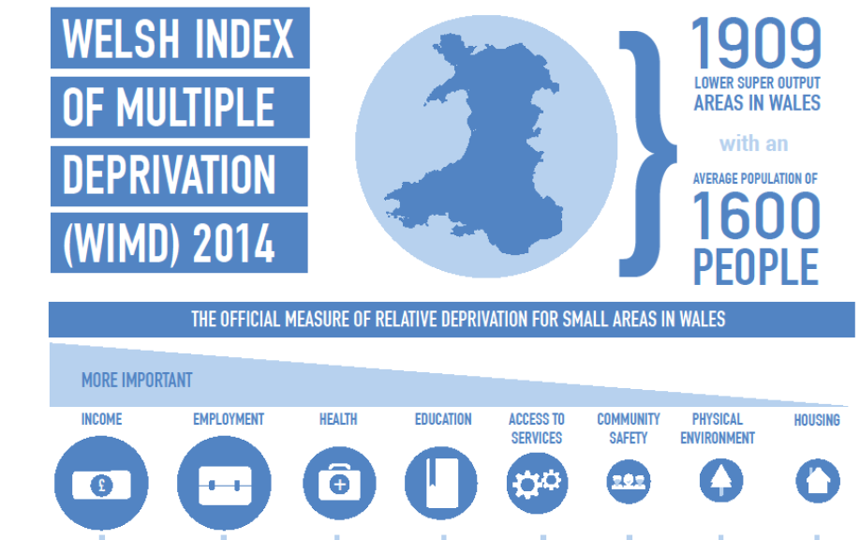
WIMD- Wales Index of Multiple Deprivation

Slide 4
Communities First in Wales
Local Authority Area | Cluster Area | Lower Super Output Areas (LSOA's) in the Cluster
Anglesey | Anglesey | Holyhead Town, Kingsland, London Road, Maeshyfryd, Morawelon, Porthyfelin 1, Tudur
Blaenau Gwent | Ebbw Fawr | Beaufort 2, Cwm 1,2, Ebbw Vale North 1,2, Ebbw Vale South 1,3, Rassau 2
 | Tredegar | Georgetown 1, Sirhowy 2,3, Tredegar Central and West 2,3,4
 | North Ebbw Fach | Blaina 1,2,3, Brynmawr 2, Nantyglo 1,2,3
 | South Ebbw Fach | Abertillery 1,2, Cwmtillery 1,2,3, Llanhilleth 1,2,3, Six Bells 1
Bridgend | Lower Bridgend | Brackla 3, Bryntirion Laleston and Merthyr Mawr 3, Cornelly 1,4, Morfa 1,2,3, Newcastle 1, Oldcastle 1, Pyle 2
 | Mid Bridgend | Bettws (Bridgend), Blackmill 1,2, Bryncoch, Llangeinor, Sarn 1, Ynysawdre 1
 | Upper Bridgend | Caerau (Bridgend) 1-4, Maesteg East 1,2, Maesteg West 3,4

Slide 5
Caerphilly | Caerphilly Basin | Aber Valley 1-4, Bedwas Trethomas and Machen 2,6, Morgan Jones 2, Penyrheol (Caerphilly) 4,8), St James 3,4
 | Mid Valleys West | Aberbargoed 1,2, Bargoed 1-4, Gilfach, Hengoed (Caerphilly) 1-3, St Cattwg 1,2 & 5
 | Upper Rhymney Valley | Darren Valley 2, Moriah 1-3, New Tredegar 1-3, Pontlottyn, Twyn Carno 1-2
 | Mid Valleys East | Argoed (Caerphilly) 1,2, Cefn Fforest 1&2, Crumlin 3, Newbridge 2, Pengam 1, Pontllanfraith 2, Risca East 1-4, Ynysddu 1
Cardiff | West | Caerau (Cardiff) 2,3,4,6,7, Ely 1,2,3,4,5,6,8,10, Fairwater (Cardiff) 4,5,7
 | BRG | Butetown 1,2, Grangetown 3,4,6,8,10, Riverside 1-3.
 | East | Llanrumney 2,3,4,6,7, Pentwyn 2,3,5,8, Rumney 4,5,6, Trowbridge 3,4,5,7,8,9,10
 | STAR | Adamsdown 1-5, Plasnewydd 7, Splott 1-8
Carmarthenshire | Carmarthenshire | Ammanford 1, Bigyn 4, Felinfoel, Glanymor 1,2,3, Hengoed 2, Lliedi 3, Llwynhendy 2,3, Trimsaran 1, Tyisha 2,3

Slide 6
Conwy | Conwy | Mostyn (Conwy) 1,2, Tudno 1,2, Colwyn 2, Glyn (Conwy) 1,2,3, Llysfaen 1, Rhiw 3, Abergele Pensarn, Kimnel Bay 1,3
Denbighshire | West/South West and Upper Denbigh | Denbigh Upper/Henllan 1, Rhyl East 3, Rhyl South East 4, Rhyl South West 1,2, Rhyl West 1,2,3
Flint | Flint Urban | Flint Castle, Flint Coleshill 2, Flint Oakenholt 1, Greenfield 1, Holywell Central, Mold West 1
 | Flint Rural | Connah's Quay Central 2,4, Queensferry, Sealand 2, Shotton Higher 1,2
Gwynedd | Gwynedd | Cadnant(Gwynedd), Marchog 1,2, Peblig (Caernarfon), Talysarn
Merthyr Tydfil | Central | Cyfarthfa 2,3, Park 3, Town 1,3, Vaynor 1
 | North | Dowlais 1,4, Gurnos 1-3, Penydarren 1,2
 | South | Bedlinog 1,2, Merthyr Vale 1,2, Plymouth (Merthyr Tydfil) 1,2, Treharris 3,4

Slide 7
Neath Port Talbot | Sandfields and Aberavon | Aberavon 2,3,4, Sandfields West 2,3,4, Sandfields East 1,2,4
 | Neath | Neath North 2,3, Brittain Ferry West 1, Neath East 1,2,3.4, Neath South 1,2, Coedffranc Central 3, Briton Ferry East 2
 | Afan | Cymmer (NPT) 1,2, Glyncorrwg, Gwynfi, Pelenna, Bryn & Cwmavon 3,4
 | Western Valleys | Ystradgynlais 1,2, Glynneath 1, Ystalyfera 1&2, Pontardawe 2, Seven Sisters, Onllwyn, Godre'r graig
Newport | Central | Pillgwenlly 1-4, Stow Hill 1,3, Victoria 3,4
 | East | Alway 2,4,5, Beechwood 3, Liswerry 1,2,5, Ringland 1,2,4,5,6
 | North | Bettws (Newport) 1-5, Malpas 2, Shaftesbury 1
 | West | Gaer 2,4,5,6, Tredegar Park 1,2
Pembrokeshire | Pembrokeshire | Haverfordwest: Garth 2, Pembroke Dock: Central, Pembroke Dock: Llanion 1, Pembroke Dock: Pennar 1, Pembroke: Monkton, Pembroke: St. Mary North

Slide 8
RCT | Porth | Cymmer (Rhondda Cynon Taf) 1,2,3,4, Rhondda 1, Trealaw 1,2,3, Ynyshir 1,2
 | Mid Rhondda | Cwm Clydach 1,2, Llwyn-y-pia 1,2, Pen-y-graig 1,2,3,4, Porth 4, Tonypandy 1
 | Upper Rhondda Fawr Cluster | Pentre 3, Treherbert 1,2,3,4, Treorchy 3, Ystrad 3,4
 | Upper Cynon Cluster | Aberaman North 1, Aberaman South 1,2,3, Cwmbach 2, Pen-y-waun 1, 2, Hirwaun 3
 | Upper Rhondda Fach Cluster | Ferndale 3, Maerdy 1,2, Tylorstown 1,2,3
 | Taf West cluster | Gilfach Goch 1,2, Tonyrefail East 1,2,3, Tonyrefail West 1,3
 | Pontypridd | Glyncoch 1,2, Hawthorn 2, Rhydyfelin Central/Llan 1,2,3, Ynysybwl 1
 | Lower Cynon | Abercynon 2, Mountain Ash West 1,2,3, Penrhiwceiber 1,2,3,4

Slide 9
Swansea | South | Castle 2,4,8, Sketty 4, Landore 2,3,4
 | East | St Thomas 1,2, Bonymaen 1,2,4, Llansamlet 6,8
 | West | Townhill 1,2,3,4,5,6, Castle 1,3
 | North East | Clydach 3, Morriston 5,6,7,9, Mynyddbach 1,2
 | North West | Penderry 1,2,3,4,5,6,7, Cockett 8
Torfaen | North | Abersychan 1,2,4, Blaenavon 2, Cwmyniscoy, St. Cadocs & Penygarn, Trevethin 1,2
 | South | Fairwater (Torfaen) 2, Greenmeadow 1,3, Llantarnam 3, Pontnewydd 1, St. Dials 1,2, Two Locks 1, Upper Cwmbran 1,3
Vale of Glamorgan | Barry Cluster | Buttrills 2, Cadoc 1,3,4, Castleland 1,2, Court 3, Gibbonsdown 1,2,4
Wrexham County Borough Council | Urban Villages Wrexham | Brymbo 2, Cefn 3, Gwenfro, Gwersyllt North 2, Gwersyllt West 1, Llay 3, Pant, Penycae, Plas Madoc
 | Caia Park & Hightown | Cartrefle 1,2, Hermitage 2, Queensway 1,2, Smithfield, Whitegate 1,2, Wynnstay

Slide 10
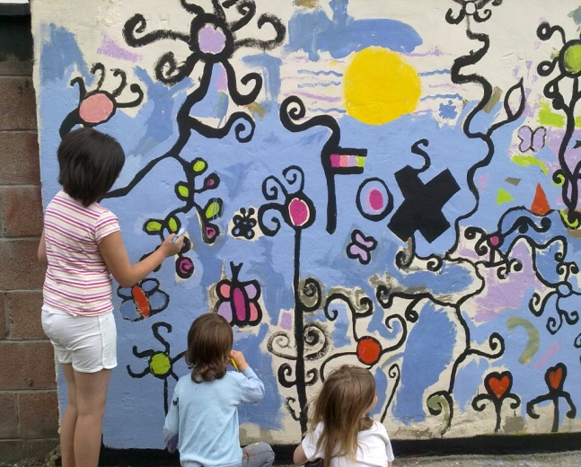
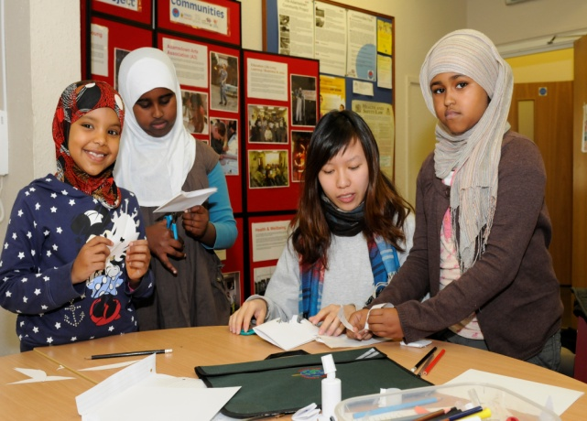
The Outcomes
Learning Communities
Supporting young people to do well at school
Supporting families to be involved in their children’s education
Lifelong Learning in communities
Improving Life Skills
Prosperous Communities
Helping People to develop employment skills and find work
Reducing youth unemployment
Financial Inclusion
Healthy Communities
Promoting Physical Wellbeing
Encouraging Healthy Eating
Reducing Risks
Supporting people to live in the community
Community Involvement

Slide 11
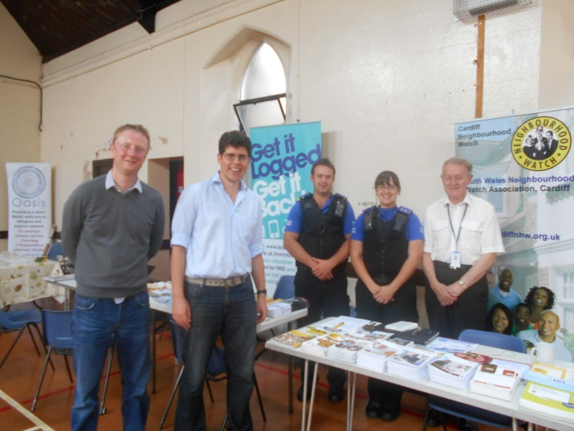

Delivery Model
Partnership
Public, private & third sector
Community groups
CCHA colleagues & other HA
Learning & training Providers
Schools
Elected representatives
Programme Bending
Rethinking the status quo
Activities that reflect the needs of the community
Sustainability
Social Capitalists
Developing strong community groups
Asset transfers & funding

Slide 12
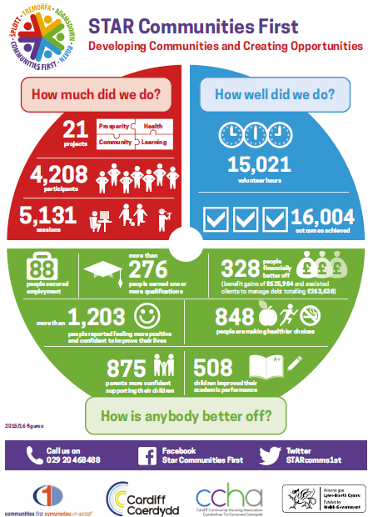

Slide 13
What type of project do we deliver?
All projects have to fit under the four headings – healthier, prosperous, learning and community involvement.
Designed by and for the community so not all areas will look the same.

Slide 14
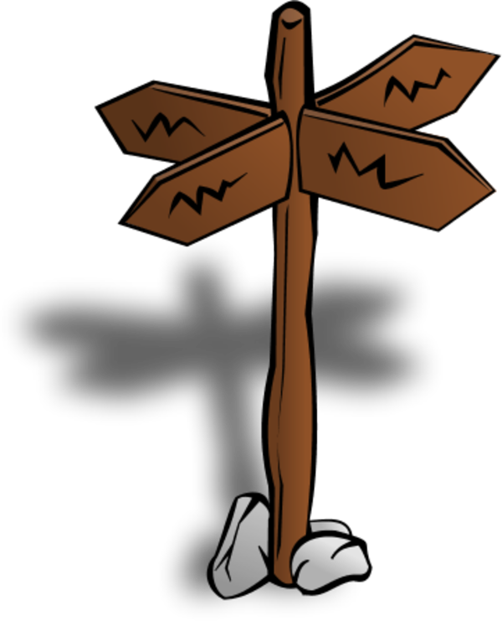
Health
Wellbeing
Food Wise
Physical Activity
Food Poverty prevention
Healthy
young people
Ageing Well
2015-16: 848 people made healthier choices
Notes:
We use the Community Development approach to engage and consult community members under 6 main health and wellbeing projects

Slide 15
Learning
    Uses a Community Development approach to engage and consult community members under 4 main strands
Employability
Lifelong Learning
Basic Skills
ESOL

Slide 16

Prosperity
Communities 4 Work
Work Club
Youth Employment
Partners
Barriers Fund
Self-Employment
Notes:
Covering all support available to STAR community.
Work Club
1:1 sessions
Partner organisations
Self-Employment Sessions – Tiny Biz
Communities For Work -
Support with starting work – clothing, interview costs, travel costs etc.

Slide 17


Financial and Digital Inclusion
Digital drop-ins
Microsoft Word Course
Skype Cafe
Financial capability workshops
Energy savings sessions
Budgeting and benefit checks

Slide 18
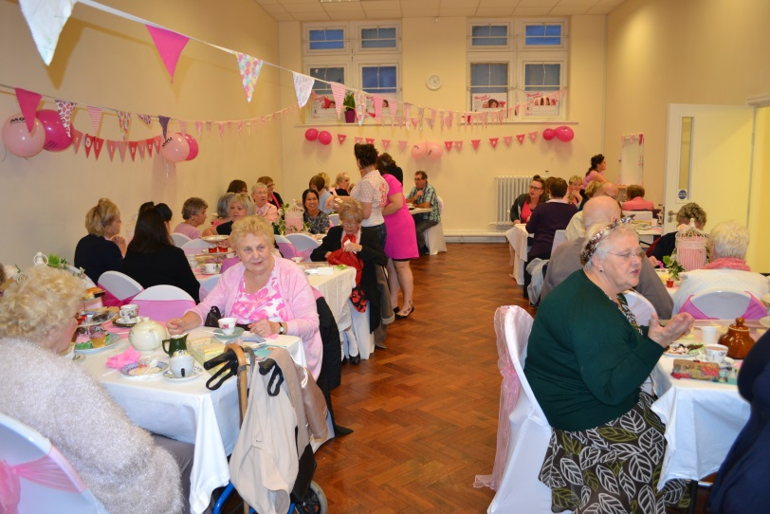
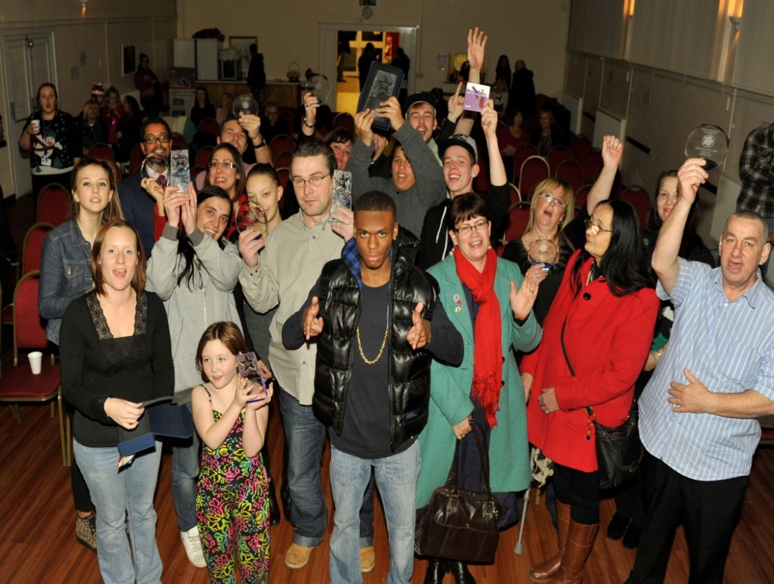
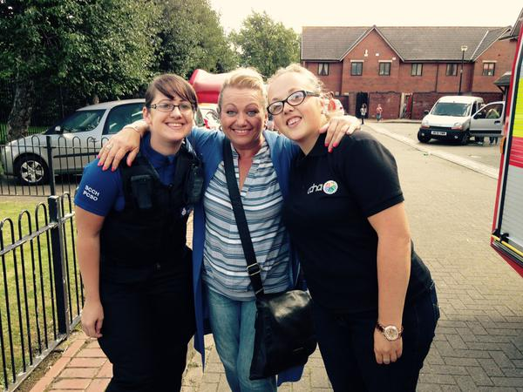
Our Community Involvement Plan

Slide 19
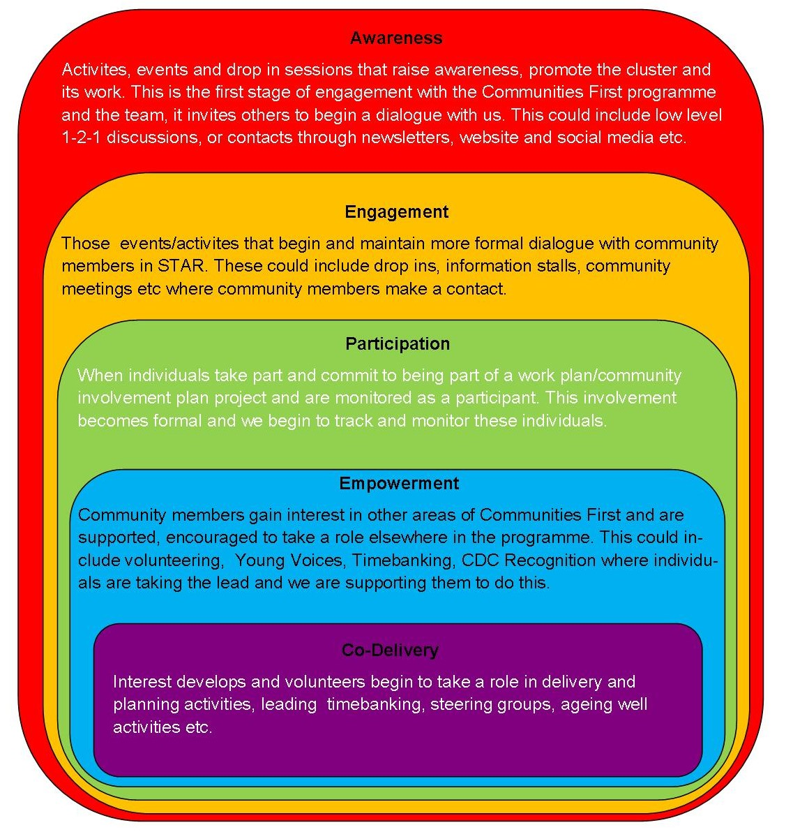
Our Community Involvement Plan encourages community members to take an active role in their community.
We have devised a structure that focusses on increasing awareness, engagement and participation in the CF programme.
We are committed to empowering individuals and working on building sustainability in the programme.
We already have a number of projects being co-delivered by community members.
STARCF is recognised by Welsh Government and partners as sector leading in this area of work

Slide 20
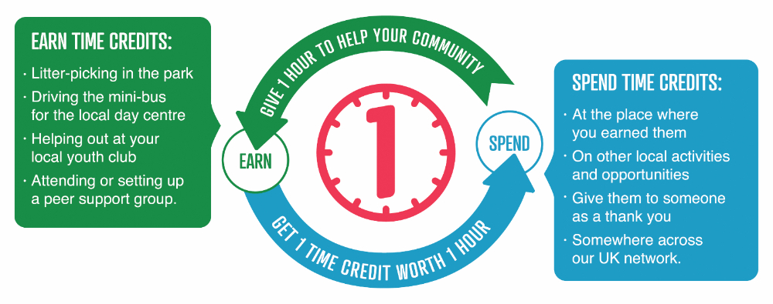

Timebanking
This project links with all areas of the delivery plan, it also recruits lots of new participants.

Slide 21
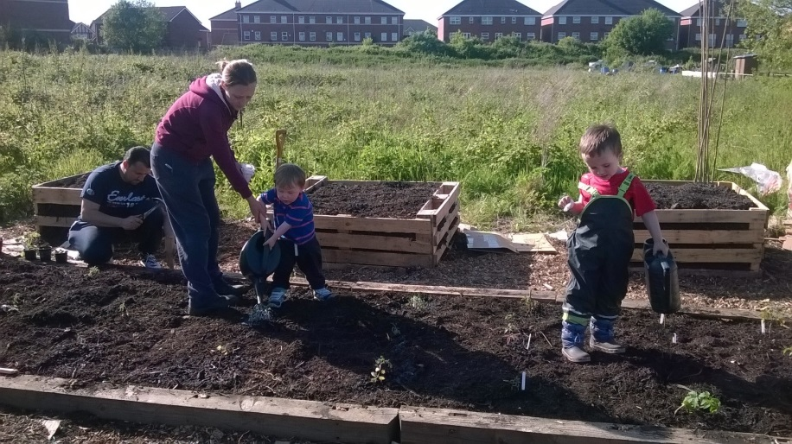
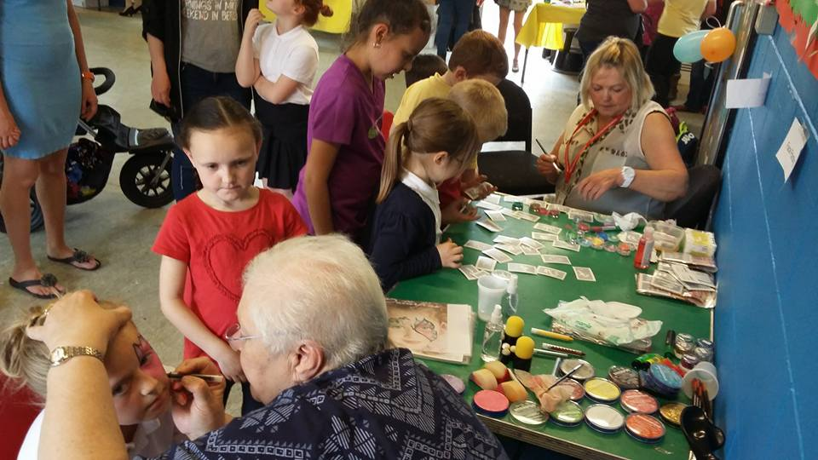
Volunteering
Encourage local people to take a lead, plan events, activities and projects that impact on the wider community.
Examples include street reps, ambassadors and local groups such as “Seren in the Community”

Slide 22
Social Prescribing
We are about to start a pilot with local GP’s where we prescribe two time credits to a patient presenting with low level anxiety, mental health and isolation.
The patient will go and spend their time credits and in return they will volunteer with Communities First
Running in other areas it has already reduced prescriptions and referrals to other services and reintegrated the individuals to their communities.

Slide 23
Why do we sit on the Frequent Fliers Project?
Local knowledge
Initiatives that meet most people’s needs
Links with other community projects
The ability to be flexible
Gives us great links with colleagues in health, housing, police, prison service and many more.
Opportunity to work together for the benefit of the individual saving all of our services time and money.

Slide 24
If you would like more information on STAR CF
www.starcommunitiesfirst.com
Email – gemma.hicks@ccha.org.uk
Phone – 029 2046 8488

